Slide 1
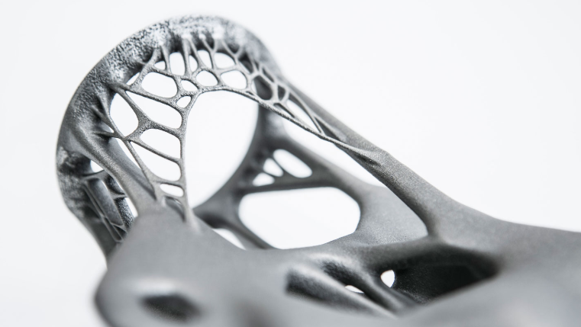
Generative Design AI
By Anthony Rogers and Yash Shetty

Slide 2
What is Generative Design?
Generative Design is the process of using software to create manufacturable parts meeting specific design criteria.
Generative Design works through an iterate evolutionary process where the software explores possible permutations of the solution and learns from what works and what does not.

Slide 3

Use In Industry: AirBus
AirBus used Autodesk’s Generative Design software to create new wall partitions.
These partitions were lighter and stronger, mimicking the growth patterns of slime mold and mammalian bones.

Slide 4
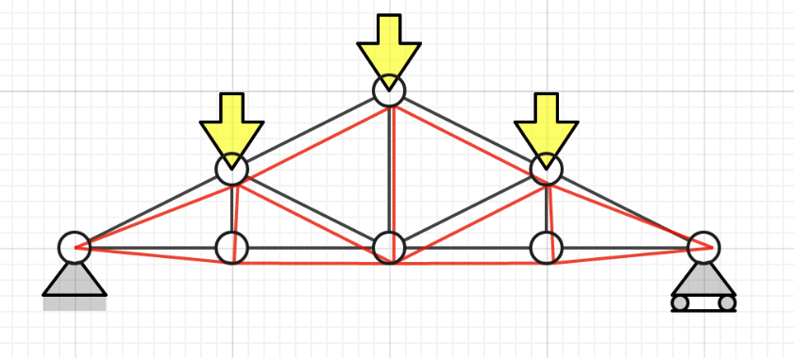
Problem
Create an algorithm to find a stable 2- dimensional structure that did not flex more than a certain threshold under its own weight.

Slide 5
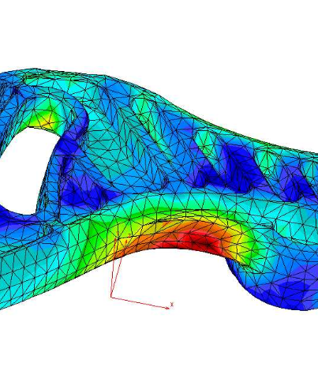
Approach
We created a script to use the Finite Element Method to solve for the displacements in the system.
Each element was modeled as a beam with each node having three degrees of freedom.
Cross-sectional area and material remained constant and were not optimized through learning.
Two points were kept fixed.

Slide 6
Approach
We modeled our problem as a Constraint Satisfaction Problem:
Variables: A beam, which consisted of two endpoints in space.
Domains: All pairs of points in a specified grid space.
Constraints:
No point must exceed the displacement threshold under its own weight
No free floating beams
Minimum of one point must reside above the X-axis

Slide 7

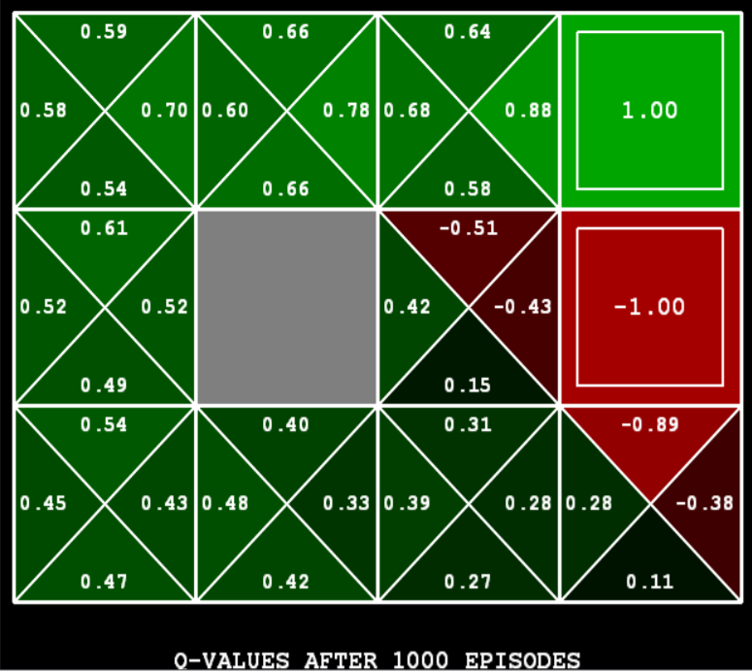
Learning
We wanted to learn a heuristic function to better pick variable assignment to lead to stable outcomes.
Ideas:
Q Learning: Running the CSP to create matrices of transitions and rewards.
Linear Regression: Using the normal equations to determine weights for a heuristic function.

Slide 8
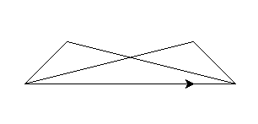
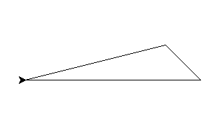
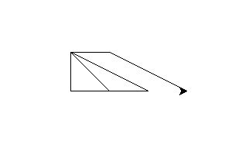
Learning
We created a dataset of structures using our CSP with a random variable assignment.
The structures from the database were decomposed into substructures to train on and develop weights from to make better assignments.

Slide 9

Learning
The target, the max displacement, was extracted from complete structures
The features were extracted from substructures
The features chosen were:
Difference of points to the right and left of the computed center of the structure
Average angle of the structure
Average displacement of the nodes
Total Length of Beams

Slide 10
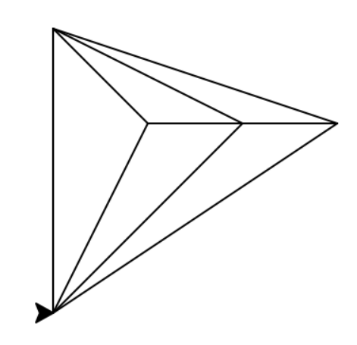
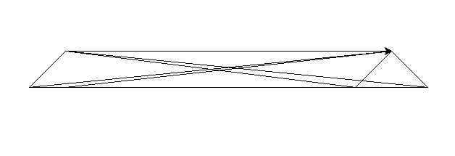
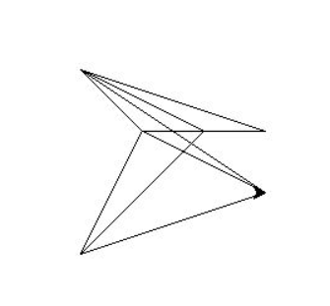
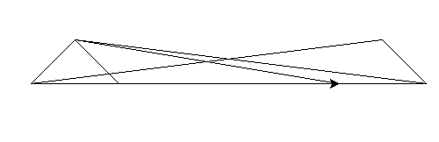
Results
These are the results of structures found using random variable assignment.
There was no optimization here. These are all the first stable structures found.
Weights for the learning were computed but we have not yet implemented the heuristic.

Slide 11
Complications:
The algorithm to create domains was inefficient initially and we could not make anything with more than 4 beams.
The domain required for Q-Learning was too large requiring a switch to using the normal equations and computing weights.
Overlapping beams along the same line was stable but resulted in many structures that were just a flat line.

